Slide 1
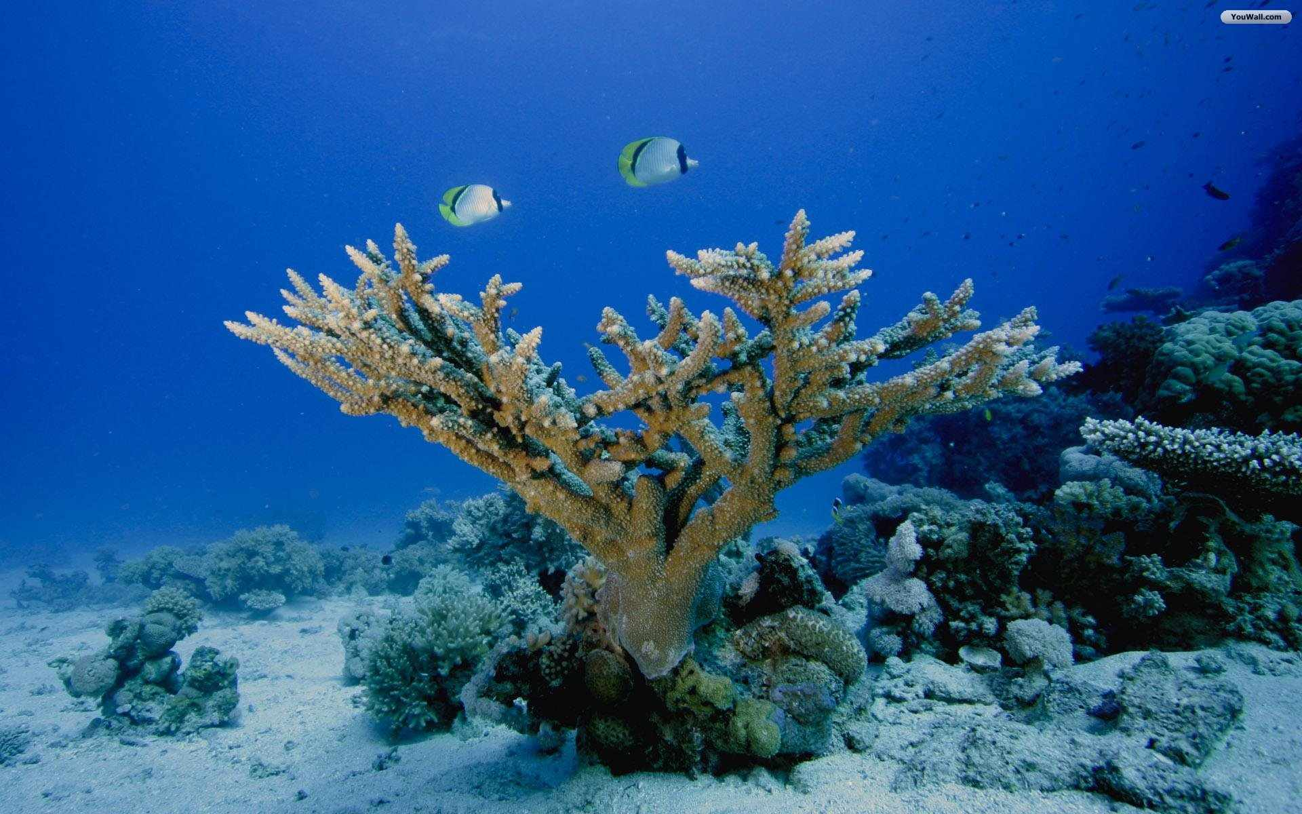

Congratulation
My dear Students

Slide 2

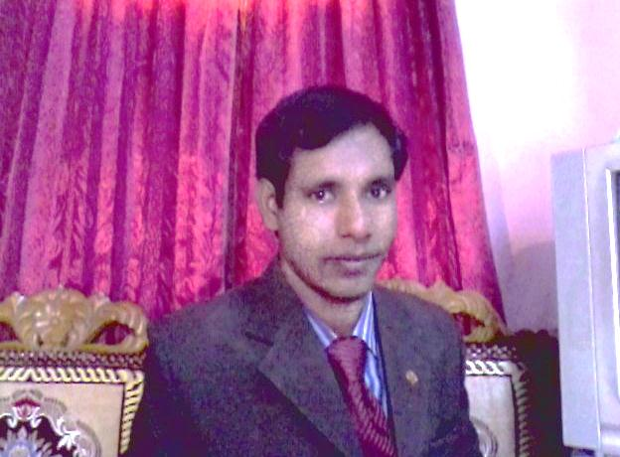
Introduction
Md. Mafidul islam
Assistant teacher
Taluk Shakhati High School
Kaligonj, Lalmonirhat,
Email; mofidulislam094@gmail.com

Slide 3

Subject;
English For To day
Class-Six
Date;

Slide 4
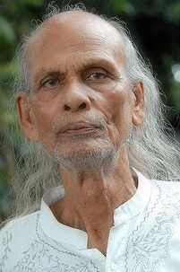
Look at the picture.
Do you know who is the man?
Sha Abdul Karim

Slide 5
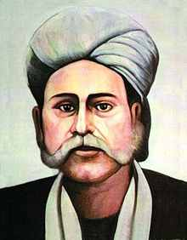
Do you know who is the man?
Hason Raja

Slide 6
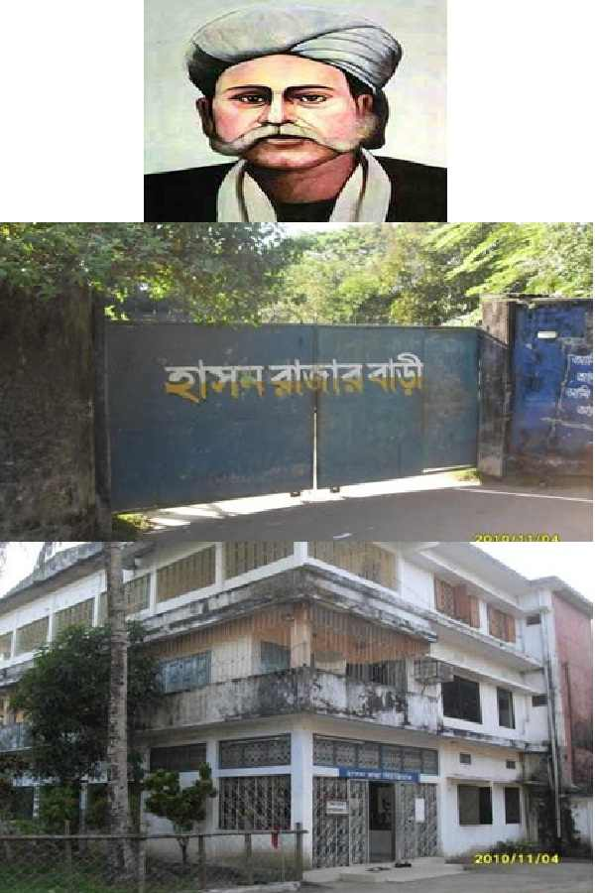
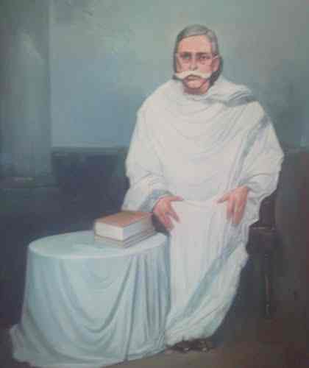

Slide 7
Topic name;
Lesson-21
Hason Raja;
The mystic bard of Bangladesh

Slide 8
Objectives of the lesson.
By the end of the lesson Student will be able to—
Ask and answer question
Read and understand text.
Write short composition.
Vocabulary.

Slide 9
Vocabulary
mystic
supernatural
meditation
Thought, contemplation.
bard
Poet, lyricist
luxury
Lavishness, opulence.
crazy
Wild, passionate, mad.
beyond
Away from, afar, out side

Slide 10
Read the text and answer the question;
Hason Raja was born in 1854 in a welthy landlord’s family in Sylhet.
He did not receive much formal education.
In his youth, he led a life of luxury.
Hason Raja wrote a lot of songs, about a thousand in number.
His book called ‘ Hason Udash’ was a published in 1906.

Slide 11

Pair work

Slide 12
Read the text and make a five sentences from the table;
Hason Raja His songs He | Are Was brought up Found Is called | In the midst of comfort and pleasure.
 |  | All sorts of pleasure and comfort insignificantly.
 |  | A famous mystic poet in Bangladesh.
 |  | Himself ‘Pagla Hason Raja’
 |  | Popular not only in Bangladesh but also in west Bengal in India

Slide 13

Answer;
Hason Raja is a famous mystic poet in Bangladesh.
He was brought up In the midst of comfort and pleasure.
His songs are Popular not only in Bangladesh but also in west Bengal in India.
He called himself ‘Pagla Hason Raja.
He found all sorts of pleasure and comfort insignificantly.

Slide 14
Evaluation;
(a) When was Hason raja born?
Hason raja was born in 1854
(b) Where did he come from?
Ans; He came from Sylhet.
(c) What was his childhood like?
Ans; Full of luxury, comfort and pleasure.
(d) How many songs did Hason Raja write?
Ans; 500

Slide 15
Home work
Write a paragraph based on the text’s information about “Hason Raja’. The paragraph should not exceed 70 words;

Slide 16

Thank you every body

